Slide 1
My Interests
By: Sara Rush

Slide 2
My Goals
Backpack across Europe
Graduate with a Masters in Business Administration
Attend a baseball game at Fenway park
Work toward a second degree in Graphic Design
Travel to Ireland and Scotland

Slide 3


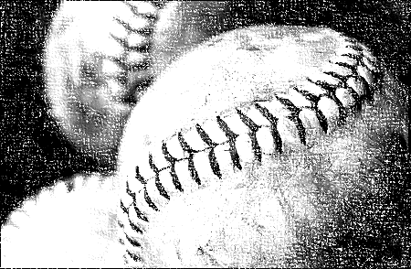
In my free time I like to…
Go Shopping
Play Softball
Read
Watch Movies
Go running
Travel
Work in the yard
Work on the house

Slide 4
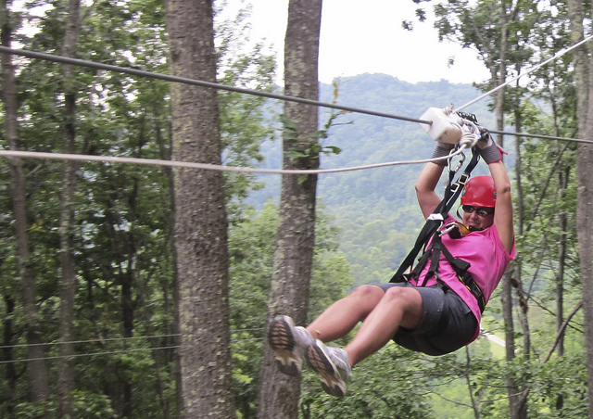
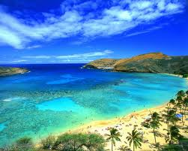
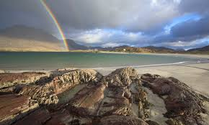
10 Things I want to do before I die…
Visit Ireland
Go zip lining in Jamaica
Visit Hawaii

Slide 5
10 Things I want to do before I die…
Visit Ireland
Go zip lining in Jamaica
Visit Hawaii

Slide 6
10 Things I want to do before I die…
Visit Ireland
Go zip lining in Jamaica
Visit Hawaii

Slide 7
My Class Schedule
Period | Class | Teacher
2nd Period | Take Charge
3rd Period | Digital Media 1
4th Period | Digital Media 1
5th Period | Take Charge
6th Period | Take Charge
7th Period | Plan
8th Period | Computer Applications

Slide 8
Things I Fear / Dislike
Heights
Cats
Spiders
Brussel Sprouts

Slide 9


My Favorite TV Shows
Revenge
Once Upon A Time

Slide 10
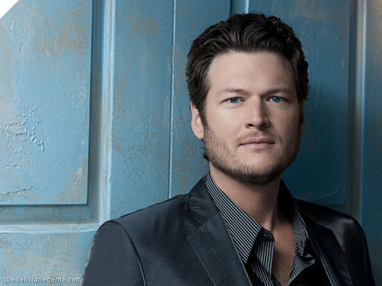
Blake Shelton

